Slide 1
Entity Relationship Diagram

Slide 2
ERD (Entity Relationship Diagram)
is modeling tool used to depict graphically a database design before it is actually implemented.
It has three basic components, namely, an Entity, Relationship and an Attribute.

Slide 3
Entity
is a real-world object distinguishable or unique from other objects.
An entity can be a concrete or physical object like employee, student, faculty, customer etc. Or it could also be conceptual or abstract like transaction, order, course, subjects etc.
It can be thought of as a noun like student, employee etc.
It is normally represented by a rectangle shape.

Slide 4
Relationship
is a way of relating one entity to another. Entities can therefore participate in a relationship.
it is commonly thought as a verb connecting the entities or nouns.
It is normally represented by a diamond shape.

Slide 5
Example of Entities with Relationship
belongs
Person
Location
enrolls
Student
Subject(s)
teaches
Faculty
Subject(s)

Slide 6
Types of Relationship
One-to-One
One-to-Many
Many-to-Many

Slide 7
Types of Relationship
has
Student
1
1
ID
One-to-One
has
Division
1
M
Program
One-to-Many
enrolls
Student
M
M
Subject
Many-to-Many

Slide 8
Types of Relationship (Crow Notation)
has
Student
ID
One-to-One
has
Division
Program
One-to-Many
enrolls
Student
Subject
Many-to-Many

Slide 9
Attribute
Refers to the characteristic or basic fact or field of an Entity or Relationship.
For example a Student entity could have the following attributes ID Number, Last Name, First Name, Address, Birth Date etc.
A relationship could also have an attribute for example an Entity name Student enrolls (relationship) to a Course/Program. Now, when you enroll you enroll on a certain date so you will have an attribute of Enrollment Date under Enroll relationship.
It is normally represented by a circle.

Slide 10
Example of Attributes
Lastname
Firstname
ID No.
Gender
Student
Address
Birth date
Email
Note : A Primary Key is Underlined, in this case the ID No.

Slide 11
Example of Attributes
Name
Chairperson
Lastname
Firstname
Program ID
Enrollment
Date
ID No.
Gender
Program
enrolls
Student
Address
ID No.
Birth date
has
Email
Faculty
Lastname
Firstname

Slide 12
Example of Attributes
Name
Chairperson
Lastname
Firstname
Program ID
Enrollment
Date
ID No.
Gender
Program
enrolls
Student
Address
ID No.
Birth date
has
Email
Faculty
Lastname
Firstname

Slide 13
Recursive ERD
manages
Employee

Slide 14
ERD with Ternary Relationship
Supplier
supplies
Product
Customer

Slide 15
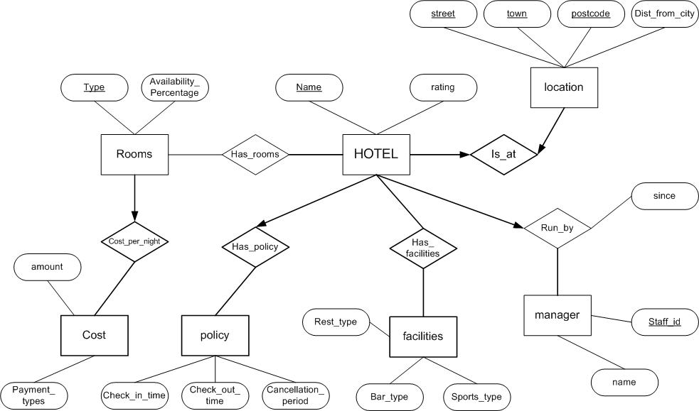
ERD (More Examples)

Slide 16
ERD (More Examples)
Manages
Code
Name
Name
Employee
Is_a_Member
Department
Dept ID
Age
Salary
Participates
Start Date
has
Start Date
City
Name
Project
Branch
Budget
Address
Release Date

Slide 17
Draw an entity relationship diagram using the
following information:
One head manages one school and one
school is managed by only one head. A
school employs many teachers but a teacher
is employed by only one school. A teacher
teaches many students and each student is
taught by many teachers.

